Slide 1
Employee Data Analysis using Excel
STUDENT NAME: KIRAN KUMAR.R
REGISTER NO: 312205527 (asunm287unm287d22bcomge075)
DEPARTMENT: B.COM (GENERAL)
COLLEGE: SRI MUTHUKUMARAN ARTS AND SCIENCE COLLEGE

Slide 2
PROJECT TITLE
Employee Performance Analysis using Excel

Slide 3


AGENDA
Problem Statement
Project Overview
End Users
Our Solution and Proposition
Dataset Description
Modelling Approach
Results and Discussion
Conclusion
3/21/2024 Annual Review

Slide 4

PROBLEM STATEMENT
Analyzing Employee Type Distribution
To analyze the distribution of employee types (fixed term, permanent, temporary) across different departments and identify potential imbalances or disparities.
Data Analysis: Examination of the provided dataset, which includes departmental names, employee type counts, and total results.
Departmental Comparison: Comparison of employee type distributions across various departments to identify any patterns or trends.
Efficiency Assessment: Evaluation of the balance between fixed-term, permanent, and temporary employees in each department and so on.

Slide 5

PROJECT OVERVIEW
Purpose:
To analyze the distribution of employee types (fixed term, permanent, temporary) across departments and identify areas for improvement.
Goals:
Identify imbalances in employee type distribution.
Assess the balance of employee types within departments.
Develop recommendations for optimizing employee
Scope:
Data analysis of departmental information, employee type counts, and total results.
Comparative analysis across departments.
Assessment of employee type balance
Methodology:
Data collection and analysis.
Departmental comparison.
Balance assessment.
Recommendation development.

Slide 6

WHO ARE THE END USERS?
Directly affected by resource allocation decisions.
Employees working within the various departments of the organization.

Slide 7

OUR SOLUTION AND ITS VALUE PROPOSITION
Solution and Value Proposition:
Solution: Departmental Resource Allocation Optimization Framework.
Components: Data collection, analysis, comparison, assessment, and recommendations.
Value Proposition: Improved efficiency, departmental performance, productivity, reduced costs, employee satisfaction, and informed decision-making.

Slide 8
Dataset Description
Dataset: Contains information about departmental resource allocation. Fields: Department, Count – Department, Count – Name. Assumptions: “Count – Name” likely represents individuals assigned to projects. Potential Analysis: Departmental size comparison, resource allocation analysis, efficiency assessment, bottleneck identification, comparison to departmental goals. Considerations: Data quality, privacy, and visualization.

Slide 9

THE "WOW" IN OUR SOLUTION
Potential Situations in the Data
Uneven Resource Distribution: Departments with high or low "Count - Name" compared to "Count - Department."
Project-Oriented Departments: High "Count - Name" relative to "Count - Department."
Administrative or Support Functions: Low "Count - Name" relative to "Count - Department."
Inefficient Resource Utilization: High "Count - Name" with low productivity.
3/21/2024 Annual Review
9

Slide 10
MODELLING
Data Cleaning and Preparation:
Handling Missing Values: Addressing any missing data points for "Count - Department" or "Count - Name."
Data Normalization: Ensuring consistency in data formats and units of measurement.
Outlier Detection and Correction: Identifying and addressing any extreme or unusual values that might skew the analysis.
Feature Engineering:
Creating Derived Metrics: Consider creating additional metrics such as "Resource Allocation Ratio" (Count - Name / Count - Department) to provide a more comprehensive understanding of resource utilization.
Categorical Encoding: If the "Department" field is categorical, converting it into a numerical format suitable for modeling.
Exploratory Data Analysis (EDA):
Visualization: Creating visualizations (e.g., histograms, scatter plots, box plots) to explore the distribution of variables, identify relationships, and detect patterns.
Correlation Analysis: Assessing the correlation between "Count - Department" and "Count - Name" to understand the relationship between departmental size and resource allocation.
10

Slide 11
Model Selection and Training:
Regression Analysis: Using regression models (e.g., linear regression, multiple regression) to predict the "Count - Name" based on the "Count - Department" and other relevant features.
Classification Models: If the goal is to classify departments into categories based on their resource allocation patterns, consider using classification models (e.g., decision trees, random forests, logistic regression).
Model Evaluation:
Performance Metrics: Assessing the model's performance using appropriate metrics (e.g., R-squared, mean squared error, accuracy, precision, recall, F1-score).
Cross-Validation: Evaluating the model's generalization ability using techniques like k-fold cross-validation.
Interpretation and Insights:
Understanding Model Coefficients: Interpreting the coefficients of the regression model to understand the impact of "Count - Department" and other features on "Count - Name."
Identifying Significant Predictors: Determining which features are most influential in predicting "Count - Name."

Slide 12
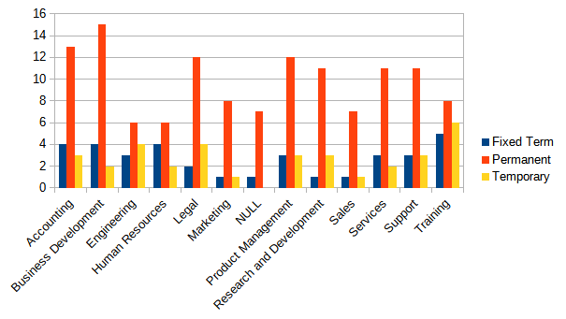
RESULTS
DEPARTMENT ANALYSIS
12

Slide 13
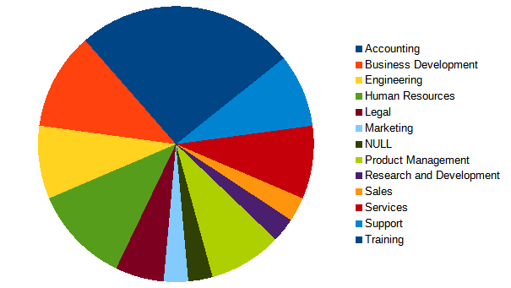
DEPARTMENT ANALYSIS

Slide 14
conclusion
Uneven resource distribution.
Project-oriented focus.
Administrative and support functions.
Inefficient resource utilization.
Recommendations:
Re-evaluate resource allocation strategies.
Implement balanced resource distribution.
Promote strategic planning.
Enhance efficiency and productivity.

